Slide 1

BUS7C1 CORPORATE STRATEGY AND INTERNATIONAL MANAGEMENT
Lecture 5: Organisation Structure and Strategy
Lecturer: Elan Kandaswamy

Slide 2

We will cover
Fundamentals of organising
Vertical and Horizontal dimension of organisation
Why organisation structure changes
Simple structure
Functional structure
Multi divisional structure
Matrix structure
Network structure
Few other types organisational design

Slide 3
Fundamentals of Organisation – Division of Labour
Benefits
Increased productivity
Specialised leads to expertise
Time saving and cost effective
Example Adam Smith's Pin factory
Notes:
we will discuss an essential principle in organisational structure: the Division of Labour. This concept plays a crucial role in improving efficiency and productivity in any organisation."
Definition:
"Division of labour refers to breaking down work into smaller, specialized tasks. Instead of one person handling an entire process, different people focus on specific parts, making the overall process more efficient."
Benefits of Division of Labour:
Increased Productivity:
"When tasks are divided, workers become faster and more efficient because they are focused on one specific role."
Specialization Leads to Expertise:
"By repeatedly performing the same task, employees gain expertise, improving quality and reducing errors."
Time-Saving & Cost-Effective:
"Less time is wasted switching between different types of tasks, and companies can optimize resource use, lowering costs."
Principle of Division of Labour:
"The principle is simple: by dividing tasks among employees, each worker becomes an expert in their area. This specialization enhances overall efficiency and output."
Adam Smith’s Pin Factory Example:
"One of the earliest and most famous examples of the division of labour comes from Adam Smith’s book, The Wealth of Nations.
He described a pin factory where the production process was divided into several small tasks.
A single worker making pins from start to finish could only make a few per day.
However, when the work was divided among specialized workers, the factory could produce thousands of pins daily."
Conclusion:
"In summary, the division of labour allows businesses to work more efficiently by letting employees specialize in specific tasks. This principle has been applied in industries for centuries and remains vital to modern-day organizations."

Slide 4
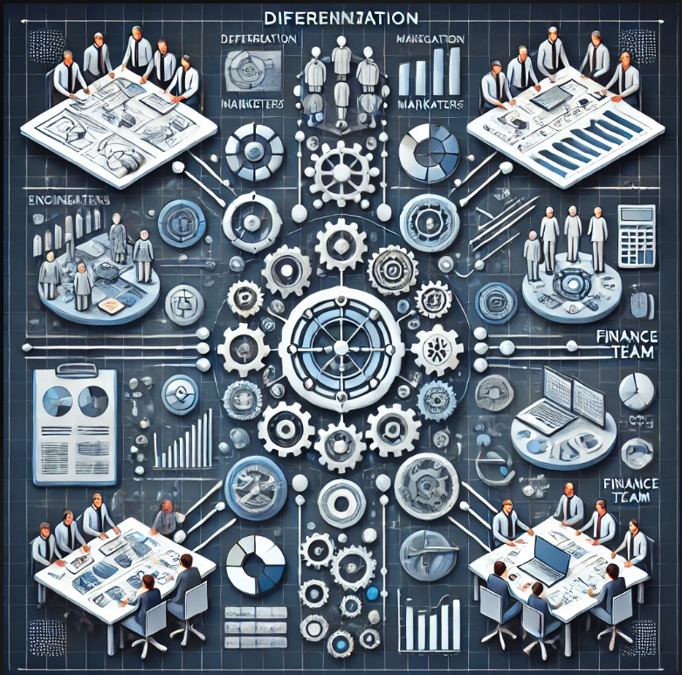
Differentiation and Integration
Notes:
"While division of labour brings efficiency and productivity, it also creates two key challenges: Differentiation and Integration."
Differentiation
Definition:
"Differentiation occurs when an organisation is composed of multiple parts, each specializing in different tasks, requiring distinct skills and work methods."
"The greater the complexity and diversity in an organisation’s operations, the higher the level of differentiation."
Example:
"Large multinational companies, like Apple or Google, have various departments—R&D, Marketing, Finance—each requiring different expertise and work methods."
"Big corporations operating in multiple countries must adapt to different markets, cultures, and regulations, increasing differentiation."
Challenge:
"With high differentiation, communication gaps and misunderstandings may arise as departments or teams use different processes and priorities.“
Integration
Definition:
"Integration is about ensuring that all the differentiated work units collaborate and coordinate their efforts effectively."
"It helps bring different teams together to achieve common organisational goals.“
Example:
"Think of a car manufacturing company. Engineers, designers, production workers, and sales teams must work together, even though they have different tasks."
"A hospital has doctors, nurses, pharmacists, and administrative staff—each with different roles—but they must integrate their efforts to provide effective patient care."
How to Achieve Integration? Clear role allocation – defining who does what
Effective communication channels Cross-functional teamwork & collaboration Leadership and coordination mechanisms
Conclusion:
"While differentiation allows organisations to specialize and excel in different areas, integration ensures they work together smoothly."
"Balancing these two factors is crucial for any business to function efficiently."
"Does anyone have questions or examples from their own experience?"

Slide 5
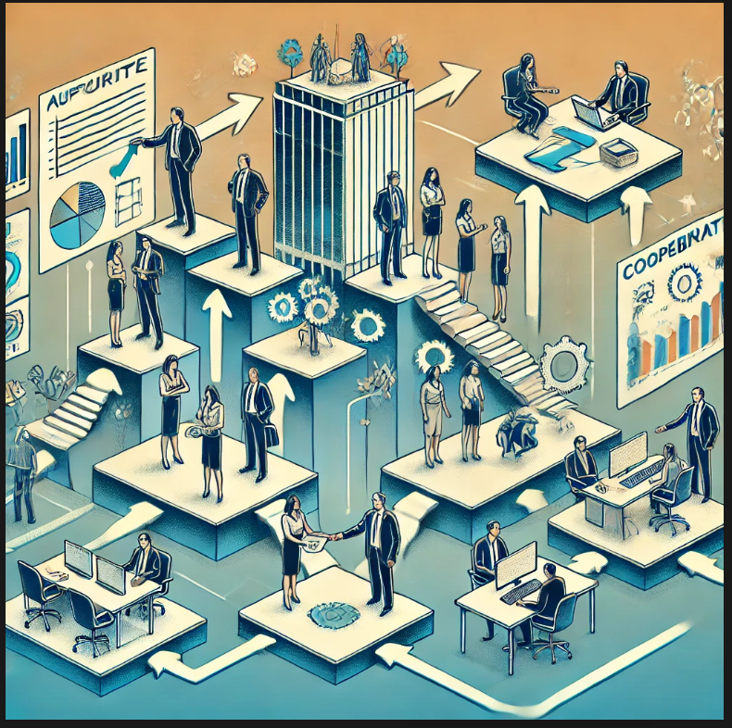
Key Elements of Organisational Structure
Notes:
Organisational Structure, is defined as how work is divided, how authority flows, and how different parts of a business coordinate their efforts."
"Essentially, it is ‘the way in which positions within a business are arranged.’"
The Key Elements of Organisational Structure
Reporting Structure:
"Who reports to whom? This establishes the hierarchy and ensures clarity in decision-making."
"For example, in a hospital, nurses report to doctors, who report to department heads."
Procedures & Controls:
"These are the rules and guidelines that keep the organisation functioning smoothly."
"For instance, companies have approval processes for expenses, quality control checks, and safety protocols."
Authority & Decision-Making:
"Defines who has the power to make decisions. Some organisations have centralized authority (decisions made at the top), while others have decentralized authority (decisions spread across different levels)."
Division of Labour:
"Work is divided into specialized roles, making tasks more manageable and efficient."
"For example, in a manufacturing firm, workers are assigned to specific tasks like assembling, packaging, or quality control."
Challenges of Specialisation & Division of Labour
While specialisation improves efficiency, it also brings two major challenges:
Cooperation: Challenge:
"When people are assigned specific tasks, they often focus only on their work, without thinking about the bigger picture."
"For example, a finance team might focus on cutting costs, while the R&D team pushes for innovation, leading to conflicts."
Solution: Encouraging cross-team collaboration Shared company goals to align departments Effective communication channels
Coordination: Challenge:
"Having the best experts in their fields—engineers, doctors, or marketers—doesn’t necessarily mean you have the best team."
"Without proper coordination, even highly skilled professionals may struggle to work together effectively."
Example:
"In a football team, having the best players doesn’t guarantee success. They need teamwork, strategy, and coordination to win games."
Solution: Strong leadership to align different teams Clear roles and responsibilities Regular meetings and feedback mechanisms
Conclusion
"An organisation’s structure defines how work gets done. While division of labour enhances productivity, cooperation and coordination are essential to ensure efficiency and success."
"Finding the right balance between specialisation and teamwork is key to a well-functioning organisation."

Slide 6
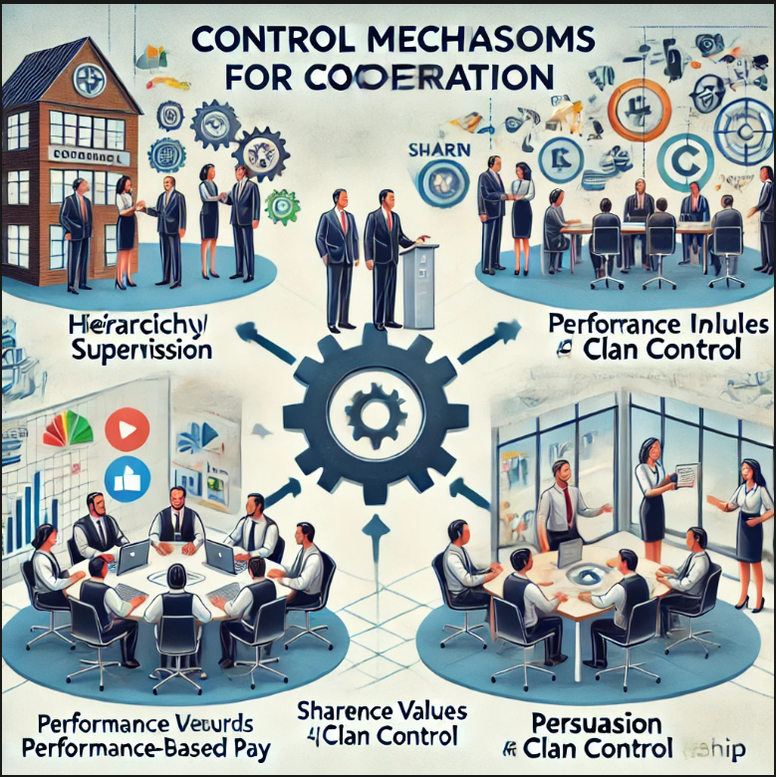
Cooperation Problem resolution
Notes:
"In any organisation, cooperation is crucial for success. But how do individuals harmonise their activities? How do we ensure that different departments, teams, and employees work together efficiently?"
"To achieve this, businesses use various control mechanisms to guide employee behaviour and problem resolution."
Control Mechanisms for Cooperation
Hierarchical Supervision
"One of the most traditional ways to ensure cooperation is hierarchical supervision."
"Supervisors and line managers oversee employees to ensure work is done efficiently and that different teams collaborate."
Example:
"In a factory, a supervisor ensures that assembly line workers coordinate their tasks to keep production flowing smoothly."
"In an office, a project manager ensures team members complete their tasks on time and work together."
Performance Incentives
"Another way to encourage cooperation is through rewards and incentives."
"People are more likely to work together if they are motivated by tangible benefits."
Types of Performance Incentives:
Pay for performance: Employees are rewarded based on their output. Piece rates: Common in manufacturing, workers are paid based on the number of units they produce. Profit bonuses: Executives receive bonuses when the company performs well, aligning their interests with company success.
Example:
"Sales teams often have commission-based pay to encourage high performance and teamwork."
"Executives at large firms receive profit-based bonuses to motivate leadership and strategic decision-making."
Shared Values (Clan Control)
"Rather than strict oversight, some organisations rely on shared values and company culture to ensure cooperation."
"Employees self-govern because they align with the company’s mission and values."
Example:
"At Google, employees are not micromanaged but are encouraged to embrace innovation and teamwork through a strong company culture."
"At Chobani Yogurt, the company fosters an inclusive and value-driven environment where employees are motivated by a sense of purpose rather than direct control."
Persuasion
"Leadership and communication play a big role in fostering cooperation."
"Instead of enforcing rules, great leaders use persuasion, rhetoric, and vision to align people toward common goals."
Example:
"A CEO delivering an inspiring speech can motivate employees to work harder and collaborate."
"A manager who effectively communicates the benefits of teamwork can persuade employees to cooperate willingly."
Conclusion
"Every organisation must ensure that employees work together efficiently. This is achieved through hierarchical supervision, incentives, shared values, and persuasive leadership."
"The right balance of these control mechanisms depends on the company’s size, industry, and culture."

Slide 7
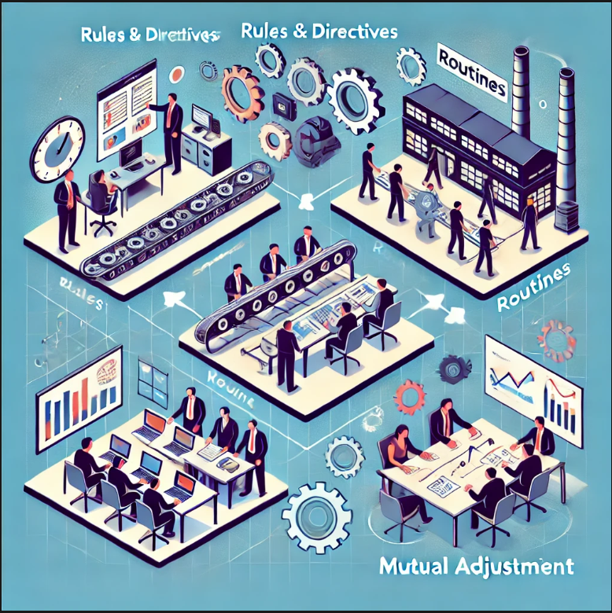
Coordination Problem resolution
Notes:
"In any organisation, coordination is essential to ensure that different tasks, teams, and departments work together efficiently."
"Coordination helps avoid confusion, delays, and inefficiencies."
"There are three main approaches to resolving coordination problems: Rules & Directives, Routines, and Mutual Adjustment."
Rules & Directives
Definition:
"Rules and directives provide clear instructions on how tasks should be performed."
"These are formal guidelines that structure work processes to ensure consistency."
Example:
"In a hospital, doctors and nurses follow standard procedures for treating patients to ensure efficiency and safety."
"A bank has strict security protocols for handling customer transactions and sensitive data."
Benefit: Reduces uncertainty and improves efficiency. Ensures everyone follows the same standard.
Routines
Definition:
"Routines are repeated processes or schedules that keep operations running smoothly."
"They help employees develop efficiency by following a structured workflow."
Example:
"In manufacturing, workers follow assembly line routines to ensure smooth production."
"Retail stores have standard opening and closing procedures to maintain order."
Benefit: Increases productivity by minimizing decision-making time. Ensures consistency in quality and service.
Mutual Adjustment
Definition:
"Mutual adjustment relies on direct communication and collaboration to coordinate tasks."
"It is most common in dynamic environments where tasks are complex and require flexibility."
Example:
"In consulting firms, teams often work together and adjust strategies based on client needs."
"In startups, employees frequently discuss and modify their work to adapt to changes quickly."
Benefit: Allows flexibility and innovation. Encourages teamwork and creativity.
Conclusion
"Coordination is key for organisational success, and companies use different methods depending on their industry and work style."
"Rules & directives work best for structured environments, routines streamline operations, and mutual adjustment is ideal for dynamic and flexible industries."

Slide 8
Vertical Differentiation
Corporate Governance:
Involves oversight by executive staff and board of directors
Key Roles:
Stockholders: Ownership and voting power
Board of Directors: Strategic oversight
CEO: Operational management and implementation
Top Management Team: Key decision-making and execution
Notes:
We will be discussing vertical differentiation and corporate governance now, focusing on the structures that shape authority within organizations.
We'll look into the roles of different groups in a company and understand the hierarchy and span of control.
Corporate Governance:
Corporate governance refers to the system by which companies are directed and controlled.
The executive staff and board of directors play crucial roles in overseeing the firm's operations.
Key Players in Governance:
Stockholders: Own the company and have voting power on major decisions.
Board of Directors: Represents the interests of stockholders. They oversee the firm's strategy and governance practices.
CEO (Chief Executive Officer): Responsible for the day-to-day operations and implementing the board’s directives.
Top Management Team: Includes high-ranking executives such as the President and Vice Presidents, who help in making key decisions on business strategy and execution.
Authority in Organizations:
Authority is the legitimate right to make decisions and command others to act.
It flows in a hierarchical manner from stockholders at the top to the operational staff on the ground level.
Hierarchy Overview:
Strategic Level (Top): Stockholders, Board of Directors, CEO.
Tactical Level (Middle): Top management team, senior managers, and department heads.
Operational Level (Bottom): Frontline employees, workers responsible for the day-to-day operations.
Span of Control:
The span of control refers to the number of people who report directly to a supervisor or executive.
For example, if a manager oversees 5 employees, then the span of control is 5.
The key concept here is balance – not having too many subordinates reporting to one person.
Henri Fayol’s Insight (1916): He suggested that the span of control should be between 3 and 6 subordinates.
Why? This range ensures that the manager can effectively supervise without being overwhelmed, maintaining a reasonable cognitive load.
Cultural Impact:
The structure and expectations for span of control may vary based on the culture of the country.
For example, cultures that value hierarchy may have a narrower span of control, while others may favor a more decentralized approach.
Cognitive Load:
We must consider the cognitive load when determining the appropriate span of control.
Cognitive load refers to the mental effort required to manage and oversee multiple subordinates.
Too many people reporting to a single manager could lead to overload, impairing decision-making and leadership effectiveness.
Conclusion:
Vertical differentiation in corporate governance ensures clear lines of authority and decision-making.
It’s important to manage span of control effectively to avoid overburdening leaders, considering both organizational structure and cultural context.
Final Thought:
The optimal balance between authority levels and span of control allows for better decision-making, smoother operations, and effective leadership at all levels of the organization.

Slide 9
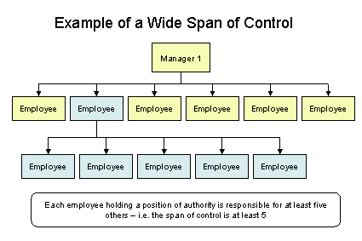
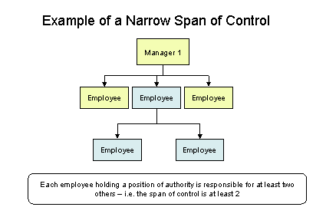
Vertical differentiation
Notes:
Now, let's explore the concept of span of control, specifically the differences between a wide span of control and a narrow span of control, and how each impacts organizational structure and management effectiveness.
Wide Span of Control:
A wide span of control occurs when a manager has many subordinates (usually more than 6).
Advantages:
Cost-Effective: Fewer managers are needed, which can reduce overhead costs.
Greater Autonomy for Employees: Workers often have more independence and responsibility in their roles.
Faster Decision-Making: With fewer layers in the hierarchy, decisions can be made more quickly.
Improved Communication: Fewer managerial layers might lead to direct communication between frontline workers and top management.
Challenges:
Manager Overload: With too many subordinates, the manager may struggle to provide sufficient guidance and support.
Lack of Supervision: Limited time with each subordinate could result in less supervision and lower quality control.
Limited Development: Managers may not have the time to mentor or develop their employees properly due to the large number of direct reports.
Narrow Span of Control:
A narrow span of control occurs when a manager oversees a small number of subordinates (usually fewer than 6).
Advantages:
Closer Supervision: Managers can provide more detailed guidance and support to each employee.
Better Control: Managers can keep a closer eye on performance and ensure alignment with company goals.
Clearer Communication: With fewer people to manage, communication is more targeted and effective.
Employee Development: Managers have more time for mentoring and coaching individual team members.
Challenges:
Higher Costs: More managers are needed, increasing the complexity and cost of the organization.
Slower Decision-Making: With more layers of management, decisions may take longer as they need to pass through several levels of authority.
Reduced Autonomy: Employees may feel micromanaged and have less room to make decisions on their own.
Key Considerations:
Organizational Size and Complexity: Larger and more complex organizations might lean toward a narrow span, while smaller, more straightforward businesses can often function well with a wider span.
Management Style and Capability: A wide span may work best in environments where managers trust their teams and delegate effectively. A narrow span is useful where more detailed control and guidance are required.
Employee Experience: More experienced workers may thrive under a wider span with less supervision, while less experienced workers may benefit from the close guidance of a narrow span.
Conclusion:
Both spans of control have their merits, depending on the organization’s size, culture, and management style.
It’s crucial to find the right balance to optimize efficiency, communication, and employee satisfaction.

Slide 10
Horizontal structure
Line Departments focus on core activities directly related to the company’s primary goods and services (e.g., Logistics, Marketing, Sales).
Staff Departments provide essential support to line departments, offering specialized services (e.g., Legal, Accounting, HR).
Simple Structure is best for small businesses, with a flat hierarchy and centralized decision-making.
Functional Structure organizes departments by specialization, enhancing efficiency but potentially creating silos.
Multidivisional (M-Form) and Matrix Structures offer flexibility for large or complex organizations, but may introduce challenges in coordination and management complexity.
Notes:
we’ll dive into the concept of horizontal structure in organizations, focusing on the differences between line departments and staff departments, and various approaches to departmentalization.
Line Departments:
Definition: Line departments are the core units that are directly involved in the organization’s primary activities, like production and delivery of goods and services.
Examples of Line Departments:
Logistics: Manages the movement of goods and materials, ensuring products are delivered efficiently.
Marketing: Responsible for promoting and advertising the company’s products or services.
Sales: Engages with customers and sells the company’s offerings.
Connection to the Value Chain: These departments directly impact the value chain by adding value to the final product or service through core activities.
Staff Departments:
Definition: Staff departments support the line departments by providing specialized services or expertise.
Examples of Staff Departments:
Legal: Provides legal counsel and handles compliance matters.
Accounting: Manages financial records, budgeting, and reporting.
Human Resources (HR): Oversees recruitment, employee relations, and benefits.
Support Role: While they don't directly generate revenue, they are essential to the smooth operation of the business and help ensure the line departments can function effectively.
Basic Approaches to Departmentalization:
Simple Structure:
Characteristics: Involves a small organization with a flat structure, where there are few departments and centralized decision-making.
Ideal For: Small businesses or startups where flexibility and direct control are crucial.
Advantages: Quick decision-making, clear communication, and minimal administrative overhead.
Challenges: May lack specialization and could be less efficient as the business grows.
Functional Structure:
Characteristics: Divides the organization into departments based on specialized functions, such as marketing, finance, HR, etc.
Ideal For: Medium-sized companies focusing on efficiency and specialization.
Advantages: Clear roles and responsibilities, expertise in each functional area, streamlined operations.
Challenges: Can lead to siloed thinking, poor communication across departments, and a lack of flexibility.
Multidivisional Structure (M-Form):
Characteristics: Organizes the company into divisions based on products, services, or geographic regions, each with its own functional departments (e.g., a division for North America and another for Europe).
Ideal For: Large companies with diverse product lines or global operations.
Advantages: Decentralized decision-making, flexibility, and autonomy for each division to respond to its market.
Challenges: Potential for duplication of resources and lack of synergy across divisions.
Matrix Structure:
Characteristics: Combines functional and divisional structures, where employees have dual reporting lines (to both a functional manager and a divisional manager).
Ideal For: Complex organizations needing collaboration across departments and projects.
Advantages: Flexibility, better communication, and resource sharing across functions and divisions.
Challenges: Can lead to confusion and conflicts due to the dual reporting lines and complexity in management.
Conclusion:
The choice of departmentalization approach depends on the organization’s size, complexity, and goals.
Line departments play a direct role in the organization’s core activities, while staff departments provide necessary support.
Understanding these structures helps optimize coordination, efficiency, and flexibility within the organization.

Slide 11
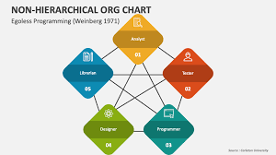
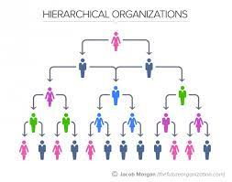
Hierarchy
Hierarchy as Control: Provides a clear chain of command, enforcing rules and regulations to maintain order and accountability.
Bureaucracy: Characterized by strict rules and procedures, ensuring consistency but can lead to rigidity and slow decision-making.
Hierarchy as Coordination: Aligns goals, allocates resources, and synchronizes activities across departments for unified action.
Modularity: Organizes the company into independent units (modules) that allow flexibility and specialization without disrupting the overall system.
Economizing on Coordination & Adaptability: Hierarchy streamlines decision-making and reduces complexity, while maintaining flexibility for quick adaptation to changes.
Notes:
Let’s now examine the role of hierarchy in organizations, focusing on how it functions for control, coordination, and adaptability. We’ll also explore the concepts of bureaucracy and modularity.
Hierarchy as Control:
Hierarchy is often used in organizations as a way to maintain control and ensure tasks are completed efficiently.
Control Mechanism: A clear hierarchy establishes authority, defining who has decision-making power at different levels.
Enforcement of Rules and Regulations: Top management ensures that processes and policies are followed, which maintains order and reduces confusion.
Bureaucracy:
Definition: Bureaucracy is an organizational system characterized by a strict set of rules, procedures, and regulations to control activities.
Bureaucracies rely on formal rules to ensure consistency, accountability, and transparency in decision-making.
While this structure ensures clear accountability, it can sometimes lead to slow decision-making and rigidity.
Pros of Bureaucracy:
Clear chain of command.
Well-defined roles and responsibilities.
Reduced risk of arbitrary decisions.
Cons of Bureaucracy:
Can be slow and inflexible.
Employees may feel restricted by excessive rules.
Hierarchy as Coordination:
Hierarchy is not just for control; it also serves as a tool for coordination across different departments and levels.
It helps to align goals, allocate resources, and ensure activities are synchronized.
Each level in the hierarchy communicates with the level directly below or above to keep everyone aligned and working towards the same objectives.
Coordination Benefits:
Ensures a unified approach to organizational goals.
Clarifies roles in cross-functional projects or initiatives.
Modularity:
Definition: Modularity refers to organizing the company into separate, self-contained units (modules) that can operate independently but still align with the overall goals of the company.
Flexibility: Each module can adapt to changing conditions without disrupting the entire organization.
Efficiency: Allows for specialization and can improve innovation by encouraging different parts of the organization to focus on specific functions.
Example: A modular approach might be seen in companies with independent product divisions or regional operations, each managing its own processes and decisions but following overarching organizational objectives.
Economizing on Coordination:
Goal: Hierarchy allows organizations to economize on coordination by organizing tasks into manageable units and defining clear reporting relationships.
Reducing Complexity: By defining clear roles and responsibilities, hierarchy reduces the need for constant communication and conflict resolution between departments.
Efficiency in Decision-Making: The chain of command streamlines decisions, reducing the need for continuous back-and-forth.
Adaptability:
While hierarchy provides control and coordination, organizations also need to remain adaptive to change.
A flexible hierarchy allows organizations to adjust to market or environmental changes without too much disruption.
Modularity, with its self-contained units, promotes this adaptability by allowing parts of the organization to evolve independently in response to external or internal changes.
Key Point: Hierarchy must balance control with flexibility, ensuring that the organization can respond to change while maintaining stability.
Conclusion:
Hierarchy plays a crucial role in control, coordination, and adaptability.
Bureaucracy enforces structure, but can be limiting, while modularity allows for greater flexibility and efficiency.
Effective use of hierarchy can lead to a well-coordinated, adaptable organization without unnecessary complexity.

Slide 12
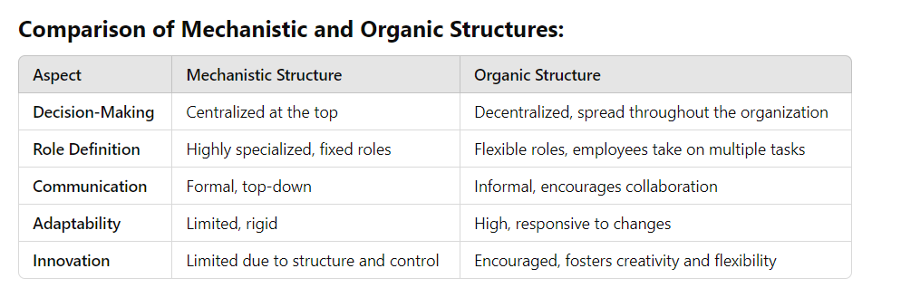
Organization structure evolution
Notes:
discuss two contrasting organizational structures: mechanistic and organic structures. These structures describe how companies arrange themselves to achieve their goals and adapt to their environment.
Both have unique characteristics and are suited to different types of organizations and operational environments.
Mechanistic Structure:
Definition: A mechanistic structure is highly hierarchical, with a clear chain of command, rigid rules, and specialized roles. It’s designed to ensure control, stability, and efficiency.
Key Characteristics:
Centralized Decision-Making: Decision-making authority is concentrated at the top levels of the hierarchy.
Clear Roles and Responsibilities: Employees have specific, well-defined tasks.
Formal Communication Channels: Communication follows formal paths, with little room for deviation or cross-functional collaboration.
Strict Rules and Procedures: Heavy reliance on standardized processes and policies to ensure consistency.
Advantages:
Efficiency: Clear roles and routines help streamline operations, especially in large, stable environments.
Consistency: Established rules ensure predictable outcomes and uniformity.
Control: Managers have a high degree of control over their subordinates, ensuring compliance with organizational goals.
Disadvantages:
Limited Flexibility: Can struggle to adapt to changes quickly due to rigid structures and decision-making processes.
Employee Dissatisfaction: A lack of autonomy and innovation can lead to disengagement among employees.
Slow Decision-Making: Due to centralized control, decision-making may be slow, especially at lower levels.
Best Suited For: Large, stable organizations with well-defined products or services, such as manufacturing or government institutions.
Organic Structure:
Definition: An organic structure is more flexible and decentralized. It emphasizes collaboration, adaptability, and fluid roles to respond quickly to changes and innovation.
Key Characteristics:
Decentralized Decision-Making: Decision-making is spread throughout the organization, empowering lower-level managers and employees.
Flexible Roles: Employees may take on multiple roles or adapt to different tasks based on needs.
Informal Communication: Communication is more informal, encouraging collaboration and cross-functional teamwork.
Adaptive and Responsive: The organization can quickly change its strategies and structure in response to market shifts or new opportunities.
Advantages:
Flexibility: Quick to adapt to changes and new challenges in dynamic environments.
Innovation: Encourages creativity and collaboration, leading to new ideas and solutions.
Employee Motivation: Employees often have more autonomy and involvement in decision-making, which can increase job satisfaction.
Disadvantages:
Lack of Clarity: The flexibility and informality may cause confusion about roles and responsibilities.
Potential for Chaos: Without clear procedures, there’s a risk of disorder and inefficiency, especially if coordination is not well managed.
Coordination Challenges: More coordination is required to ensure everyone is aligned with the overall goals.
Best Suited For: Dynamic industries or startups where innovation, rapid response to change, and collaboration are crucial (e.g., tech companies, creative industries).
Both mechanistic and organic structures have their place, depending on the organization's size, goals, and the environment in which it operates.
Mechanistic structures are ideal for stable, large-scale organizations that prioritize efficiency and control, while organic structures are best for dynamic, fast-changing environments where flexibility, innovation, and responsiveness are key.
The right structure depends on the business needs and the external factors influencing the organization.

Slide 13
Organisational structures
https://www.youtube.com/watch?v=f60dheI4ARg

Slide 14
Organization structure evolution
Growth by Volume: Organizations first grow by increasing production or operational volume, leading to a more specialized functional structure.
Growth by Geography: Expansion into new regions or countries results in a geographic or regional structure to manage local operations.
Growth by Integration (Vertical & Horizontal): Companies expand by integrating suppliers, distributors, or competitors, adopting divisional or matrix structures to handle complexity.
Growth by Product/Business Diversification: Companies diversify into new industries or markets, requiring a divisional or matrix structure with decentralized decision-making.
Evolution of Structure: A firm's growth pattern—whether by volume, geography, integration, or diversification—determines the appropriate organizational structure to support its needs.
Notes:
explore how organizations evolve and grow over time, and how their structure adapts as they expand.
Firms typically grow in predictable patterns, and each stage of growth requires a corresponding shift in organizational structure to support that growth.
Stage 1: Growth by Volume
Description: At the initial stages, companies grow by increasing their production or operational volume to meet demand.
Key Focus: Scaling operations, increasing output, and improving efficiency.
Structural Changes:
Functional Structure: As the business grows in size, it will likely adopt a functional structure, with departments like production, sales, and marketing becoming more specialized.
Standardization: Increased volume requires standardized processes to maintain efficiency and consistency.
Example: A small manufacturing firm increases its production capacity to meet rising customer demand, adding more workers, equipment, and production lines.
Why This Matters:
As volume grows, it becomes necessary to organize the company into specialized units to handle the increased complexity of operations.
Stage 2: Growth by Geography (Internationalization)
Description: Once a company has established itself in one location, it may expand into new regions or countries.
Key Focus: Expanding to new markets and managing operations across different geographies.
Structural Changes:
Geographic or Regional Structure: The company begins to organize its operations around regions or countries. New divisions may be created for different geographic areas.
Challenges: The firm must navigate cultural differences, legal regulations, and logistical challenges in each new market.
Example: A company like Tesco expands from the UK into international markets such as China and Eastern Europe, adapting its approach to local needs.
Why This Matters:
Geographic expansion requires a structure that allows for localized decision-making, while still ensuring alignment with the overall organizational strategy.
Stage 3: Growth by Integration (Vertical and Horizontal)
Description: Integration occurs when companies grow by acquiring or merging with other companies, or by extending their operations along the value chain.
Vertical Integration: A company expands by acquiring suppliers or distributors to control more parts of the production process.
Horizontal Integration: A company acquires competitors or expands into new product lines to increase market share or diversify its offerings.
Structural Changes:
Divisional or Matrix Structure: With multiple business units or divisions, the company may adopt a divisional or matrix structure to handle different products, services, or stages in the value chain.
Coordination Complexity: As the company integrates vertically or horizontally, it faces the challenge of managing more complex coordination and communication across its expanded operations.
Example: Tesco, in addition to growing geographically, has vertically integrated by acquiring suppliers and horizontally by diversifying its product range beyond just groceries.
Why This Matters:
Integration changes how the organization is structured, adding layers of complexity and requiring a more sophisticated management approach.
Stage 4: Growth by Product/Business Diversification
Description: At this stage, firms diversify their offerings by entering new industries or markets, either through developing new products or acquiring businesses in unrelated sectors.
Key Focus: Broadening the business portfolio to reduce risk and capture new opportunities.
Structural Changes:
Divisional or Matrix Structure (Continued): A fully diversified company often operates through a divisional structure, where each division is responsible for a specific product line or business unit. A matrix structure may also be used for more complex coordination.
Decentralized Decision-Making: As the company diversifies, decision-making may shift to be more decentralized, with individual divisions having greater autonomy to operate according to their specific market needs.
Example: A company like General Electric (GE) diversifies across a range of industries, from appliances to healthcare to finance, and structures its operations into divisions based on each business line.
Why This Matters:
Diversification requires a flexible and decentralized structure to allow for the management of diverse product lines or business units, each with its own set of challenges and opportunities.
Conclusion:
A firm’s growth is typically predictable in stages, and its organizational structure evolves accordingly to support that growth.
From volume-based growth to geographic expansion, integration, and finally diversification, each phase brings about structural changes that allow the company to operate more efficiently and effectively at larger scales.
A firm’s growth pattern directly influences its structural form, and understanding this evolution is key to maintaining organizational effectiveness at every stage of growth.
Final Thought:
By recognizing the stages of growth, companies can strategically align their structure to support long-term success and sustainability.

Slide 15
Structure evolution
Simple structure
Sales Growth
Coordination and control problems
Functional structure
Sales Growth
Coordination and control problems
Multidivisional structure

Slide 16
Simple structure
Owner-Manager Role: The owner-manager makes all major decisions and directly supervises all activities, with little delegation.
Simple Business Focus: Typically paired with focus strategies, offering a single product in a single geographic market.
Limited Organizational Complexity: Works well for small businesses but struggles with complexity as the business grows.
Managerial Challenges: Owner-managers often lack the experience and skills needed to manage specialized and complex tasks.
Growth Issues: As the business expands, the simple structure becomes ineffective, leading to inefficiency and management challenges.
Notes:
The simple structure is often seen in small businesses or startups where the owner and manager roles are combined.
It’s a straightforward organizational design that works well in the early stages of growth but faces challenges as the business expands.
Key Features of Simple Structure:
Owner-Manager Role:
The owner-manager makes all major decisions directly, controlling all key aspects of the business.
Centralized Decision-Making: There’s no formal delegation, meaning the owner-manager is at the center of all decisions and operations.
Monitoring and Control:
The owner-manager is responsible for monitoring all activities and ensuring that tasks are completed according to the company’s objectives.
Direct Supervision: The staff plays a minor role and acts as an extension of the owner-manager’s authority, with little delegation.
Focus on Simple Business Strategies:
The structure is usually paired with focus strategies and business-level strategies, where the company aims to offer a single product or service in a single geographic market.
Common Example: A local bakery or small retail shop offering only one line of products in a specific location.
Growth Challenges in Simple Structure:
Increased Complexity:
As the business grows, the complexity of operations increases, which can be difficult to manage with a simple structure.
Example: More employees, greater operational demands, and increased customer interactions can overwhelm the owner-manager.
Managerial and Structural Challenges:
The simple structure becomes less effective as the organization expands, creating challenges in managing the specialized tasks and functions.
Limited Skill Set: Owner-managers may lack the organizational skills or experience to handle complex tasks effectively.
Ineffective Management:
As the company grows, the owner-manager struggles to manage multiple functions (marketing, finance, HR, etc.) and specialized tasks.
Result: This leads to inefficiencies, mistakes, or delays in operations as the company outgrows its simple structure.
Conclusion:
Simple Structure is effective for small companies focused on a single product or market, but as the business expands, it creates complexity and challenges.
Without formal delegation or structure, the owner-manager may struggle to manage the growing complexity, making it harder to scale operations effectively.
Key Takeaway:
The simple structure works for initial growth but must evolve as the business grows in complexity to avoid inefficiencies and managerial overload.

Slide 17
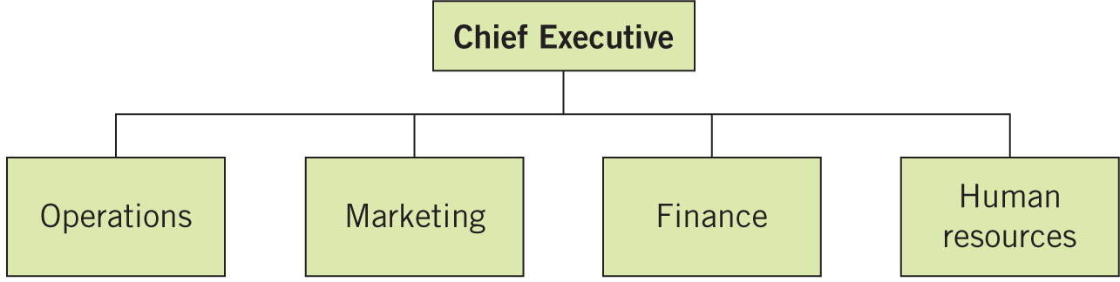
The Functional structure
Notes:
The functional structure is one of the most common organizational designs, especially for businesses focused on efficiency and specialization.
It divides responsibilities based on key business functions or specialties such as production, marketing, finance, and research.
Key Features of the Functional Structure:
Division of Labor by Function:
In a functional structure, tasks and responsibilities are grouped based on the primary functions that are crucial to the business.
Example:
Production oversees manufacturing.
Sales manages customer relationships and revenue generation.
Research & Development (R&D) focuses on innovation and product development.
Finance handles budgeting, accounting, and investments.
Clear Specialization and Expertise:
Each department specializes in its own area, enabling employees to develop deep expertise and efficiency in their respective functions.
Benefits: Specialized roles allow for more focus, streamlined processes, and higher performance within each functional area.
Hierarchical Structure within Functions:
Each function typically operates with its own hierarchy, with a department head or manager overseeing the team.
The structure may include sublevels within each function (e.g., assistant managers or team leaders).
Advantages of the Functional Structure:
Efficiency and Expertise:
By grouping similar tasks together, employees can develop specialized skills, leading to increased efficiency and productivity.
There’s less overlap or redundancy since each function has clear responsibilities.
Clear Reporting Lines:
Employees report to their functional managers, creating clear lines of authority and responsibility.
This reduces confusion and improves accountability.
Easier Management of Specialization:
Management can focus on specific areas of the business, ensuring each function is optimized and performing well.
Challenges of the Functional Structure:
Silos and Lack of Communication:
While functional areas work efficiently, there may be challenges in communication and coordination between different departments (e.g., R&D might not communicate enough with Sales or Marketing).
This can lead to a lack of collaboration or missed opportunities.
Limited Flexibility:
The rigid focus on individual functions can make the organization less flexible when it comes to responding to changes or new projects that require cross-functional teamwork.
Potential for Conflict:
Different functional areas may have competing priorities (e.g., production wants to focus on cost control, while marketing wants to invest in new advertising campaigns), which can lead to conflict if not managed properly.
Conclusion:
The functional structure is ideal for organizations seeking efficiency and specialization in well-defined roles.
It works best for companies with stable environments and clear functional needs but may face challenges as the business grows and requires more cross-functional coordination.
Key Takeaway:
While the functional structure provides clear specialization and efficiency, organizations must be mindful of communication and coordination barriers as they scale.

Slide 18
The Multidivisional structure
Divisional Structure: The organization is split into separate divisions based on products, services, or geographic regions, each with its own set of functions (e.g., marketing, finance, HR).
Autonomy and Decentralized Decision-Making: Each division operates with a high level of autonomy, allowing for quicker decision-making tailored to specific markets or product lines.
Handling Complexity and Diversity: The multidivisional structure is designed to manage the complexity and diversity that arise as a company grows and diversifies its offerings.
Flexibility and Accountability: Divisions are accountable for their performance, making it easier to track success and ensure that strategies are aligned with market needs.
Challenges: Potential issues include duplication of resources, coordination problems between divisions, and a loss of economies of scale.
Notes:
The Multidivisional Structure (often referred to as M-Form) is an organizational structure where a company is divided into separate divisions, each responsible for specific products, services, or geographic areas.
This structure is designed to handle the complexity and diversity that often arise as organizations grow, especially when a functional structure becomes less effective at managing varied needs.
Key Features of the Multidivisional Structure:
Divisions Based on Products, Services, or Geography:
The company is split into independent divisions, each of which operates like its own company.
These divisions are often organized around specific product lines, customer segments, or geographic regions.
Example: A global company like Johnson & Johnson might have divisions for medical devices, pharmaceuticals, and consumer health products.
Autonomy within Divisions:
Each division typically has its own management team and full set of functions, such as marketing, sales, R&D, and finance.
This allows for more decentralized decision-making, with each division acting somewhat independently but still aligning with the overall corporate goals.
Focus on Diversity:
The multidivisional structure often arises as companies face increasing diversity in their products, services, or markets.
The aim is to overcome the limitations of functional structures, which can struggle to address the varied needs of different product lines or market segments.
Advantages of the Multidivisional Structure:
Better Handling of Complexity and Diversity:
With divisions focusing on specific areas, the company can better address the unique needs of each market or product.
Example: A company like General Electric (GE) uses this structure to manage different divisions such as aviation, healthcare, and energy, which each require different strategies and expertise.
Decentralized Decision-Making:
Divisions have more autonomy to make decisions that are tailored to their specific products, customers, or regions.
This allows for faster decision-making and a more responsive approach to changes in the market or environment.
Flexibility and Accountability:
Each division is responsible for its own performance, making it easier to track success and hold leaders accountable.
Example: PepsiCo uses a multidivisional structure to separately manage its beverages, snacks, and nutrition segments, allowing each to operate efficiently according to market demands.
Challenges of the Multidivisional Structure:
Duplication of Resources:
Each division has its own functional departments, which can lead to duplication of roles and resources.
Example: Multiple divisions may have their own HR, marketing, and finance teams, which can be costly and inefficient.
Coordination and Communication Issues:
While divisions have autonomy, the lack of integration between them can lead to coordination challenges, especially for cross-divisional projects.
Example: Coca-Cola might face challenges in aligning global strategies between its beverage divisions in different regions, leading to inconsistency in branding or operations.
Loss of Economies of Scale:
Due to the autonomy of each division, the company may lose some of the economies of scale that could be achieved in a more centralized structure.
Example: A company might find it harder to negotiate bulk procurement discounts if each division operates separately rather than centrally managing purchases.
Examples of Multidivisional Structure in Practice:
*General Electric (GE):
Divisions include areas such as healthcare, energy, and aviation.
Each division has its own management, operations, and focus areas.
*PepsiCo:
Divided into beverage and snack divisions (such as Frito-Lay, Gatorade, Pepsi, and Tropicana), each with its own set of functions to cater to their distinct markets.
*Sony:
Divided into separate divisions based on products like electronics, entertainment (movies, music), and gaming (PlayStation).
Conclusion:
The Multidivisional Structure helps large companies manage diverse product lines or geographical regions more effectively by giving autonomy to individual divisions while still maintaining overall control.
It is particularly effective for companies with complex, varied operations, allowing them to respond to market demands more quickly and efficiently.
Key Takeaway:
The M-Form structure enhances flexibility, decentralizes decision-making, and improves accountability by organizing divisions around specific products, services, or geographic areas. However, it requires careful management to avoid duplication and communication challenges.

Slide 19
Functional structure and competitive strategies
Cost Leadership Strategy: Utilizes a formal structure to focus on efficiency, cost control, and process improvement across functions, like in Walmart, to offer low prices and streamline operations.
Differentiation Strategy: Uses a less formal structure to foster innovation and creativity, emphasizing R&D and marketing, as seen with Apple, to create unique products that justify premium prices.
Integrated Cost Leadership/Differentiation Strategy: A hybrid structure that balances efficiency and innovation, combining formal processes for cost control with flexibility for product differentiation, as demonstrated by Toyota.
Formal Structure for Efficiency: In cost leadership, a formal, process-oriented structure ensures standardized operations, reducing costs and increasing productivity.
Informal Structure for Flexibility: In differentiation, an informal structure allows for cross-functional collaboration, fast decision-making, and responsiveness to customer needs and market trends.
Notes:
The functional structure organizes a company by its core activities, grouping employees based on their specialized skills (e.g., marketing, R&D, production).
Different competitive strategies require different organizational approaches. The functional structure can be tailored to align with a company’s strategy, whether it's focused on cost leadership, differentiation, or a mix of both.
1. Cost Leadership Strategy (Formal Structure)
Key Features:
Companies pursuing a cost leadership strategy aim to offer products or services at the lowest possible cost in their industry to attract a broad customer base.
The functional structure under this strategy is typically formal, with clear hierarchies, processes, and a focus on efficiency and cost reduction.
Organizational Focus:
The emphasis is placed on improving operational efficiency and reducing costs across various functions (e.g., production, procurement, logistics).
Example: Companies like Walmart focus on cost leadership by streamlining operations, reducing waste, and leveraging economies of scale to offer low prices. A formal functional structure supports this by standardizing processes and centralizing decision-making to control costs.
Advantages of a Formal Structure for Cost Leadership:
Efficiency: Standardized processes and procedures reduce costs and improve productivity.
Cost Control: Centralized decision-making helps in controlling expenditures across functions.
Process Improvement: A formal structure emphasizes continuous improvement in processes to maintain a competitive edge in terms of cost.
2. Differentiation Strategy (Informal Structure)
Key Features:
A differentiation strategy focuses on creating unique products or services that stand out from competitors, often justifying higher prices.
Companies pursuing differentiation usually operate with a less formal structure, allowing for greater flexibility, creativity, and innovation.
Organizational Focus:
The emphasis is on innovation, research and development (R&D), and marketing to differentiate the company’s offerings from competitors.
Example: Apple is a prime example of a company that pursues differentiation. Their R&D and marketing departments play a key role in developing and promoting innovative products, like the iPhone, which have unique features that justify a premium price. The informal structure supports this by fostering collaboration, creativity, and fast decision-making across functional areas like design, engineering, and marketing.
Advantages of an Informal Structure for Differentiation:
Flexibility: An informal structure encourages adaptability and quick responses to changes in the market or technological innovations.
Innovation: Cross-functional collaboration is easier, leading to more creative ideas and innovations.
Customer Focus: Teams can rapidly adjust to customer needs and market trends, which is essential for differentiation.
3. Integrated Cost Leadership/Differentiation Strategy (Hybrid Structure)
Key Features:
Integrated cost leadership/differentiation strategy combines elements of both cost leadership and differentiation, aiming to offer products that are both cost-effective and distinct in the market.
This requires a balance between formal and informal structures to ensure operational efficiency while fostering innovation and differentiation.
Organizational Focus:
The company must streamline processes to control costs, while also investing in R&D and marketing to offer differentiated products or services.
Example: Toyota is a great example of a company that follows an integrated cost leadership/differentiation strategy. Toyota produces high-quality, affordable cars by leveraging advanced manufacturing processes that minimize costs. At the same time, they focus on innovation (e.g., hybrid technology with the Prius) and marketing to differentiate their products. Toyota’s structure balances formal processes in manufacturing with flexibility in R&D and marketing.
Advantages of an Integrated Structure:
Flexibility and Efficiency: The hybrid structure allows the company to maintain cost leadership while also responding quickly to changes in the market and driving innovation.
Adaptability: The company can adapt to competitive pressures from both cost-conscious and quality-focused customers.
Market Reach: By offering differentiated products at competitive prices, companies can target a wider range of consumers.
Conclusion:
The functional structure can be adapted to fit different competitive strategies.
Cost Leadership Strategy: A formal, process-oriented structure helps companies streamline operations and control costs.
Differentiation Strategy: A more informal structure encourages creativity and innovation, enabling companies to develop unique products.
Integrated Cost Leadership/Differentiation Strategy: A hybrid structure balances formal efficiency with informal innovation to achieve both cost control and differentiation.
Key Takeaway:
Companies must align their functional structure with their competitive strategy. Whether the focus is on low cost, unique offerings, or a combination of both, the organizational structure should support the goals and operational needs of that strategy.

Slide 20
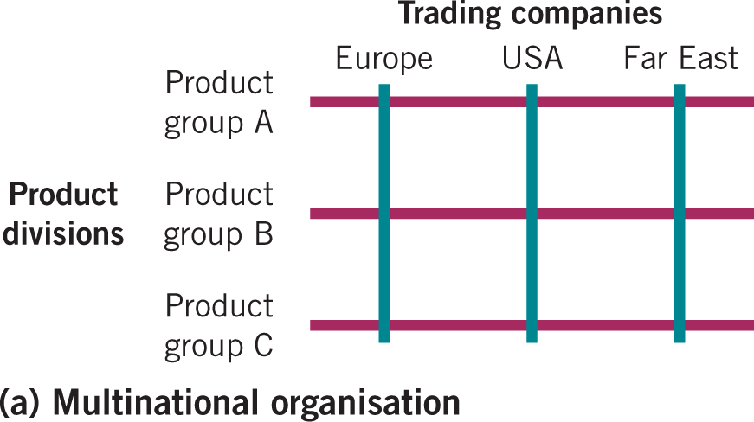
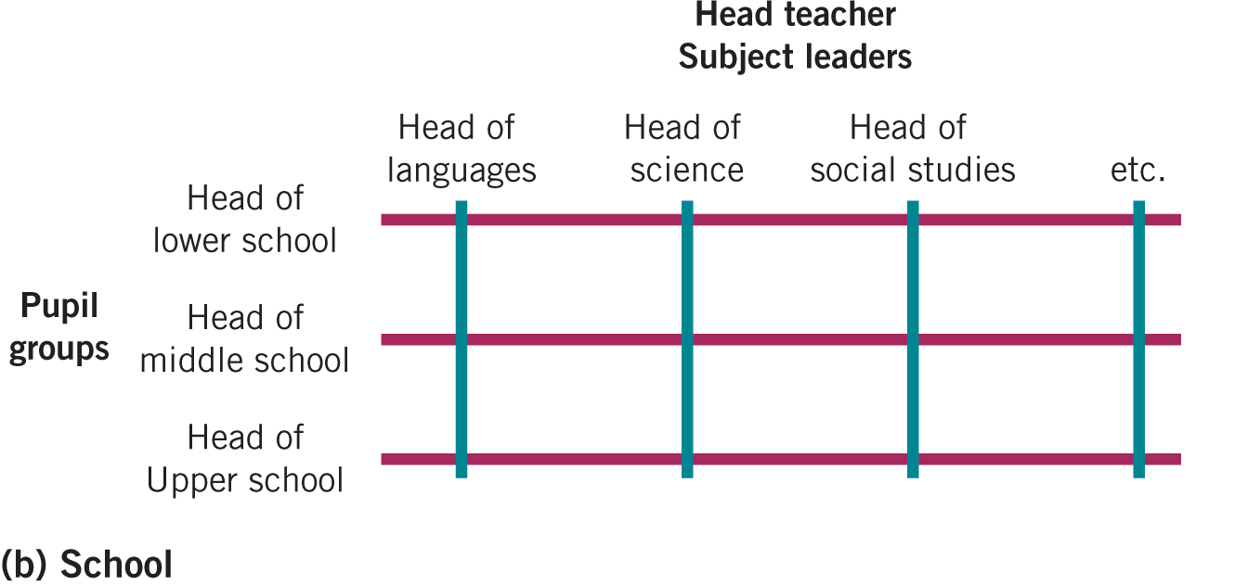
The Matrix structure
Notes:
The matrix structure is a complex organizational design that combines two or more structural dimensions, such as product divisions, geographic regions, or functional areas.
This structure aims to provide flexibility, improve coordination, and enhance collaboration across various parts of the organization.
Employees in a matrix structure typically report to two managers: one based on their functional expertise (e.g., marketing, finance) and one based on the product or geographic division they are part of.
Key Features of the Matrix Structure:
Dual Reporting Relationships:
Employees have two managers: one functional manager and one divisional (product or geographic) manager.
This dual reporting creates a more dynamic and flexible work environment but can also lead to conflicts in priorities or role confusion.
Example: An employee in the marketing department may report to both the head of marketing and the manager of a specific product line, like "Consumer Electronics."
Combining Functional and Divisional Structures:
The matrix structure integrates elements of functional and divisional structures:
Functional Structure: Focused on areas of expertise, such as marketing, finance, and R&D.
Divisional Structure: Based on product lines, geographic regions, or customer groups.
This combination allows the organization to maintain specialization while being more responsive to different product or market needs.
Example: A global company like Microsoft has regional divisions (e.g., North America, Europe) and functional departments (e.g., R&D, marketing) working together on specific product initiatives.
Collaboration Across Functions and Divisions:
The matrix structure encourages greater collaboration between functional specialists (e.g., engineers, marketers, accountants) and divisional managers (e.g., product managers or regional leaders).
Cross-functional teams can be formed to address specific goals, projects, or product developments, leading to more innovative solutions and faster decision-making.
Example: In a company like Procter & Gamble, a team working on a new product may consist of members from marketing, R&D, finance, and supply chain, all collaborating under the guidance of both product and functional managers.
Flexibility and Adaptability:
The matrix structure provides flexibility to respond to changes in the market or organizational needs.
With this flexibility, a company can quickly shift resources between product lines or regions, adapting to market demands or competitive pressures.
Example: A company like Siemens uses a matrix structure to quickly reallocate engineering resources between projects in different countries, optimizing for regional needs while leveraging functional expertise.
Advantages of the Matrix Structure:
Improved Communication and Coordination:
The matrix structure improves communication and information flow between different parts of the organization, as employees frequently interact with colleagues from various functional areas and product lines.
Enhanced Problem-Solving:
The combination of functional expertise and divisional focus leads to more diverse ideas and better problem-solving capabilities, as employees with different perspectives collaborate to achieve goals.
Better Resource Utilization:
The ability to share resources across functions and divisions allows the organization to optimize the use of specialized skills and knowledge across different projects.
Challenges of the Matrix Structure:
Confusion and Conflicting Priorities:
Employees may experience confusion or frustration from reporting to two managers with potentially conflicting priorities or goals.
For example, the product manager may demand immediate action on a project, while the functional manager may prioritize long-term efficiency goals.
Increased Complexity:
The matrix structure can be complex to manage because it requires coordination between multiple managers and teams, potentially leading to inefficiencies if not well organized.
Potential for Power Struggles:
Having two managers can create power struggles or disagreements about resource allocation, project timelines, and strategic direction.
This requires strong leadership and clear communication to avoid conflicts.
Conclusion:
The matrix structure offers significant advantages in terms of flexibility, collaboration, and resource utilization, particularly for large, complex organizations with diverse products, services, or markets.
However, the dual reporting structure can create challenges in terms of managing priorities, communication, and decision-making.
Companies with matrix structures need to invest in strong leadership, clear roles, and communication systems to minimize confusion and maximize the benefits of this approach.
Key Takeaway:
The matrix structure is ideal for organizations that need to manage multiple dimensions, such as products and functions, but requires careful management to handle the complexity and potential conflicts that arise from dual reporting relationships.

Slide 21
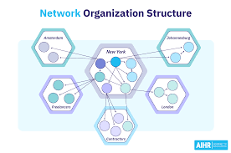
Network structure
Notes:
A network organization is an alliance of autonomous companies, often with a single function, that collaborate to produce goods or services. Each company within the network maintains its independence but works together to create value.
A dynamic network is a more flexible arrangement where partner companies come together for temporary projects and can quickly reassemble to respond to changing environmental conditions or market demands.
Both types of networks enable organizations to be more agile and responsive to external factors such as market fluctuations, technological advancements, or sustainability efforts.
1. Network Organization:
Key Features:
Autonomous Companies: The network is made up of independent companies, each specializing in a single function or part of the value chain.
Collaboration: These companies collaborate to deliver a final product or service, leveraging each other’s strengths without merging or losing autonomy.
Example: In countries like Sweden and Denmark, companies often form network organizations to create more efficient supply chains. For instance, a network could involve an automotive manufacturer, a parts supplier, and a logistics provider that work together but remain separate entities.
Benefits of Network Organization:
Specialization: Each company focuses on what it does best, whether it’s production, marketing, or logistics.
Flexibility: Because the companies are autonomous, they can adjust their operations independently in response to market changes.
Cost Efficiency: Network organizations can reduce overhead by not having to maintain all functions in-house, allowing each company to be more cost-effective.
2. Dynamic Network:
Key Features:
Temporary Partnerships: A dynamic network involves temporary collaborations between companies that come together to work on specific projects or adapt to changing conditions.
Reconfigurability: These networks can be assembled and reassembled quickly depending on the needs of the project or the external environment.
Example: In the context of sustainability, companies may form dynamic networks to tackle environmental challenges. For example, a coalition of technology firms, manufacturers, and environmental consultants may come together to develop a sustainable product or initiative. Once the project is complete, the network disbands, or new partnerships are formed to address different needs.
Benefits of Dynamic Networks:
Flexibility and Agility: These networks are highly adaptable, allowing companies to quickly respond to new opportunities or threats.
Innovation: Dynamic networks can foster innovation by bringing together diverse skill sets and expertise, especially when tackling complex issues like sustainability.
Reduced Long-Term Commitment: Companies in a dynamic network don’t have to commit to long-term partnerships, which reduces risk while still allowing them to address pressing challenges.
3. Example of Dynamic Networks in Sustainability:
Sustainability Efforts:
Companies often come together in dynamic networks to address sustainability challenges. For example, different organizations in the tech and energy sectors might form a temporary network to create a renewable energy solution, such as a solar-powered product or energy-efficient technology.
Example: A dynamic network may form around tackling sustainability in fashion. One company could focus on sustainable fabric sourcing, another on innovative manufacturing techniques, and another on consumer education or product distribution. This flexible network approach allows each organization to contribute its expertise while working together on a larger sustainability goal.
4. Challenges of Network and Dynamic Organizations:
Coordination Complexity: Although flexibility is a benefit, managing and coordinating activities among multiple independent companies can be complex, requiring strong communication and collaboration.
Trust and Relationship Building: Network organizations, especially dynamic ones, rely heavily on trust between companies. Frequent shifts in partners can create challenges in maintaining strong, long-term relationships.
Dependency: Companies in a network can become dependent on one another, and any disruption in one company’s operations can affect the entire network.
Conclusion:
Both network organizations and dynamic networks offer significant advantages in terms of flexibility, specialization, and adaptability to changing environments.
In particular, dynamic networks are well-suited for industries or projects requiring innovation and quick responses to shifts in the market, like sustainability efforts.
Companies within these networks must navigate the challenges of coordination, trust, and dependency while maximizing the benefits of collaboration and resource sharing.
Key Takeaway:
Network organizations provide a collaborative approach where specialized companies work together for mutual benefit, while dynamic networks offer temporary partnerships that are adaptable to evolving challenges, such as those encountered in sustainability efforts. Both structures require strong management to coordinate effectively and maintain long-term success.

Slide 22
Other types organizational Stuctures
Delayering:
This is where positions within the hierarchy are abolished.
Delayering cuts costs and means that the lines of communication from top to bottom are shorter.
• Project-based organizations
• Network structures
• Permeable organizational boundaries: Open innovation
• Platform organizations: Uber
• Virtual organizations: Covid and virtual organisation
Notes:
Delayering refers to the process of removing layers within an organization’s hierarchy, often resulting in fewer management levels and a flatter organizational structure.
The goal of delayering is to cut costs, improve communication, and increase flexibility by reducing the distance between decision-makers and those executing the tasks.
As organizations adapt to changing market conditions and new technologies, new organizational structures have emerged, including project-based organizations, network structures, and virtual organizations.
1. Delayering:
Key Features:
Elimination of Management Layers: Delayering removes middle management positions, creating a more flat structure.
Cost Reduction: By reducing the number of managers, organizations can cut salary and administrative costs.
Improved Communication: With fewer layers, communication from top to bottom becomes more direct and faster, reducing delays and miscommunications.
Benefits:
Speed: Faster decision-making and execution, as employees can directly communicate with senior leaders.
Employee Empowerment: Employees may have more autonomy, as fewer management layers mean more responsibility and decision-making power at lower levels.
Flexibility: With fewer hierarchies, organizations can adapt more quickly to changes in the market or customer needs.
Challenges:
Overloaded Managers: Senior managers may take on more responsibilities, leading to increased workload.
Loss of Mentorship: The removal of middle management can result in fewer mentoring opportunities for junior employees.
2. Project-Based Organizations:
Key Features:
In project-based organizations, the structure revolves around projects, not functional or divisional divisions.
Teams are organized around specific projects, which have clear goals and timeframes.
Once the project is complete, teams disband, and resources are reallocated to new projects.
Benefits:
Focus on Outcomes: Teams are highly focused on achieving project goals, leading to higher efficiency and innovation.
Flexibility: Teams can quickly pivot between projects based on changing priorities.
Example: Companies like Tesla or Google often form project-based teams to work on new products or technological innovations. Once a project is completed, teams are reassigned to the next venture, ensuring agility.
3. Network Structures:
Key Features:
A network structure is a decentralized organizational form where independent companies or business units collaborate but retain their autonomy.
It allows for the exchange of resources and expertise across different parts of the organization.
Benefits:
Collaboration Across Boundaries: Network structures encourage cross-functional, cross-departmental collaboration, and knowledge sharing.
Scalability and Agility: By leveraging the capabilities of multiple independent companies, networks can quickly scale or shift focus based on market needs.
Example: Companies like Nike have adopted network structures, relying on third-party suppliers, distributors, and manufacturers to maintain flexibility in production and distribution while focusing on their core business of design and branding.
4. Permeable Organizational Boundaries (Open Innovation):
Key Features:
Permeable boundaries allow for the flow of information, ideas, and resources both inside and outside the organization.
This is central to the concept of open innovation, where companies collaborate with external partners (e.g., universities, research labs, competitors) to innovate and solve complex problems.
Benefits:
Increased Innovation: By accessing external knowledge and resources, companies can create more innovative products or solutions.
Faster Time-to-Market: Leveraging external ideas and technologies can reduce the time required to bring new products to market.
Example: Procter & Gamble's "Connect + Develop" program encourages partnerships with external innovators to co-create products, which accelerates product development and keeps the company competitive.
5. Platform Organizations:
Key Features:
A platform organization operates by creating a digital or physical platform where other businesses or individuals can interact and exchange value.
These platforms act as intermediaries between users (e.g., customers) and service providers.
Benefits:
Scalability: Platforms can grow quickly because they leverage third-party providers or users to generate value.
Network Effects: As more users join the platform, its value increases for everyone involved.
Example: Uber: The ride-sharing platform connects drivers with customers through a mobile app, acting as an intermediary without owning the physical assets (like cars). This business model enables rapid scalability and low operational costs.
6. Virtual Organizations:
Key Features:
Virtual organizations rely on digital tools and technology to operate remotely, often without a physical office or traditional structure.
Teams are spread out geographically, and the organization relies on online collaboration platforms to maintain communication and coordination.
Benefits:
Remote Work: Enables employees to work from anywhere, reducing overhead costs and increasing flexibility.
Access to Global Talent: Virtual organizations can tap into a broader talent pool across different regions and time zones.
Example: During COVID-19, many organizations adopted virtual structures to maintain operations while adhering to lockdown measures. For example, Zoom and other video conferencing platforms became essential for maintaining communication and collaboration during the pandemic.
Challenges:
Communication Issues: Remote work can lead to communication breakdowns or a feeling of isolation among team members.
Technology Dependence: Virtual organizations are heavily reliant on technology; any disruption in connectivity can impact productivity.
Conclusion:
Delayering reduces costs and improves communication by flattening organizational hierarchies, but it also requires careful management to avoid overburdening senior leaders.
The modern organizational landscape includes project-based structures, network organizations, and virtual environments, all of which are designed to increase flexibility, foster innovation, and adapt to market changes.
As companies embrace these new forms, they also face challenges such as communication barriers and the need for strong coordination across decentralized teams.
Key Takeaway:
Modern organizational structures like delayering, network organizations, platform models, and virtual organizations offer opportunities for flexibility, cost reduction, and innovation. However, they require robust communication systems, clear roles, and adaptability to successfully thrive in a dynamic business environment.

